Slide 1

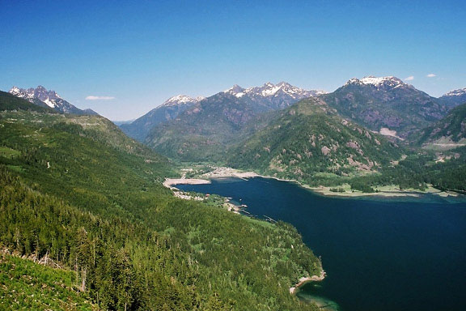
Tahsis Emergency
Programming

Slide 2
What are some of the main concerns?
Fire
Large scale urban interface fires or wildland fires that may threaten the safety of the community.
Flooding
Heavy rainfall or tsunami that can impact lower areas of the community and threaten critical infrastructure.
Storms
Heavy winds and rainfall that can threaten lives, cause damage to infrastructure and private property.
Earthquake
Seismic activity that can threaten structural integrity of buildings or trigger a tsunami or landslide.
Landslide
Hillsides becoming dislodged and bringing with it boulders, trees or other debris that could come falling down.

Slide 3
Fire
Wildfires can threaten our community in variety of ways.
Immediate threat involving flames threatening the community.
Smoke can also have a damging effect on our health.
Threat to infrastructure such as power lines, highways or telecommunication.
Report a wildfire:
1 800 663-5555 or *5555 on a cell

Slide 4
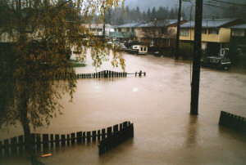
Flooding
The Village of Tahsis has recently completed a flood survey analysis of the municipality.
The lower area of the community is the most prone area to flood.
Flooding can also cut off the road in and out of town preventing goods and services entering our community
Flooding can displace residents as well as damage property.

Slide 5
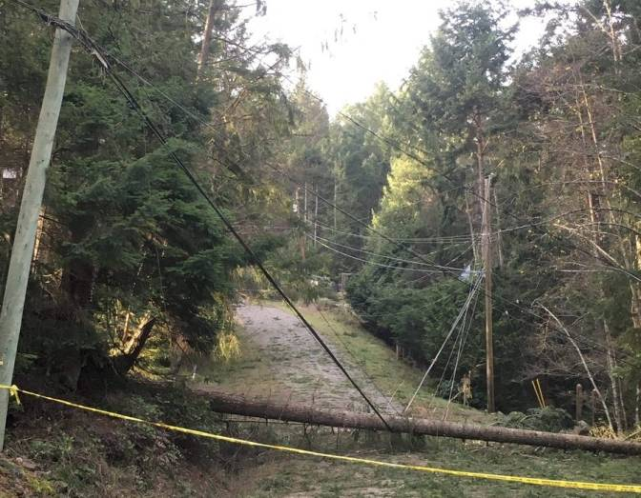
Storms
Some storms can bring heavy winds that can knock out power for long periods of time.
Heavy rainfall can cause localised flooding leading to road closures and possibly evacuations.
Storm surges can also effect shoreline properties and bring with it ocean debris.

Slide 6
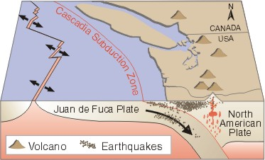
Earthquake
Tahsis is located within the Cascadia Subduction Zone which has the potential of causing a powerful earthquake.
Earthquakes have the potential to trigger tsunamis. It is important to go to higher ground after feeling a major earthquake.
Tsunamis can be triggered by earthquakes that happen far away and can offer some warning of potential landfall.

Slide 7

Landslide
The hilly terrain around Tahsis can be a problem for landslides.
Heavy rainfall, seismic activity and soil degradation has led to landslides in the past and still pose a threat.
Landslides can also cut off roads and take out infrastructure.

Slide 8
How does a local authority declare a state of local emergency?
A declaration of a state of local emergency must be made either by a bylaw or resolution if made by a local authority, or by order if made by the head of a local authority.
Bylaw or Resolution Assuming time permits, the municipal council or the regional board could meet to establish a bylaw or resolution that authorizes a declaration of a state of local emergency.
Order An order can only be issued by the head of a local authority. In the case of a municipality, the head is the mayor (or designate). The head of the local authority must use best efforts to obtain consent of the other members of the local authority and must, as soon as possible, convene a meeting of the local authority to assist in directing response activities.

Slide 9
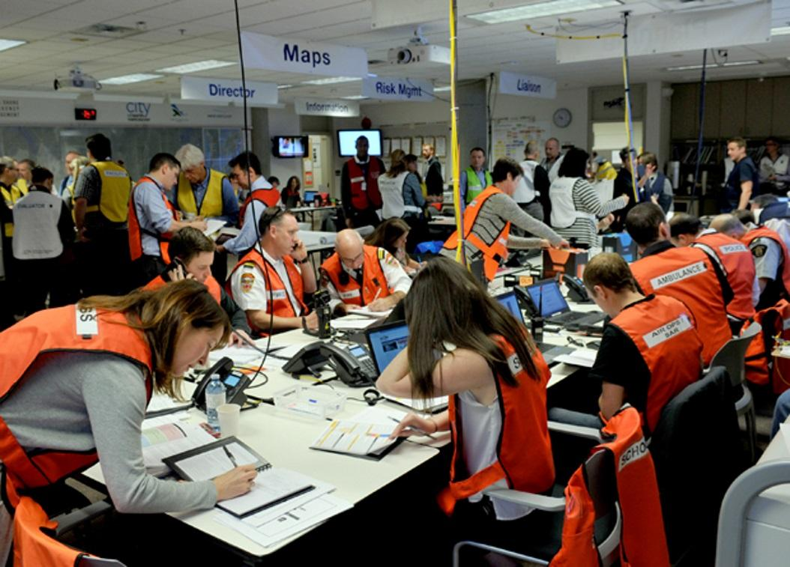
Establishing the EOC
In the event of an emergency an Emergency Operations Centre (EOC) will be activated at the Village office.
The EOC is a physical facility designated for the gathering, analysis and dissemination of disaster information. It is also the facility in which decisions and policies governing the emergency response are planned and implemented.
Emergency Operations Centres (EOC) are normally activated at the request of the Incident Commander or senior municipal officials to provide overall jurisdictional direction and control, coordination and resource support.
The village office also has a back up generator and communication room with HAM radio to stay connected in the event of power or communication loss.

Slide 10
ISSUING AN EVACUATION ORDER
The EOC in consultation with the hazard Incident Commander and available hazard specific subject matter experts makes a determination that an Evacuation Order is required
Notify mayor, council and first responder agencies
Based on advice, map the geographic boundaries for the Order and declare a State of Local Emergency (SOLE), publish online and notify the public

Slide 11
ISSUING AN EVACUATION RESCIND
The EOC in consultation with the hazard Incident Commander and available hazard specific subject matter experts and technical specialists, makes the determination that an Evacuation Rescind is required
Notify mayor, council and first responder agencies
Notify evacuated residents of Rescind

Slide 12
Emergency Notifications
Social media
Traditional media
Door-to-door
Automated notification systems (i.e. Connect Rocket (778-762-3201), Alert Ready)
First responders
Evacuation Siren

Slide 13

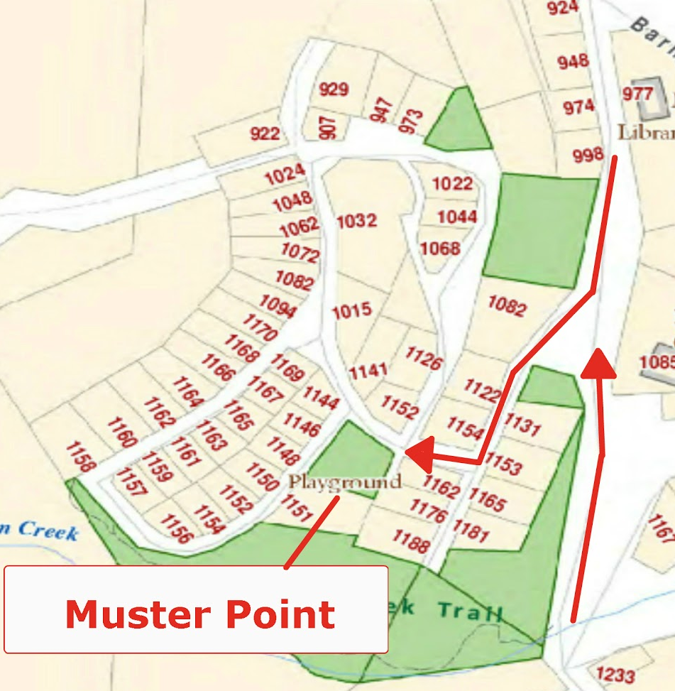
Tsunami muster point
Impending risk of tsunami
Emergency containers
Limited food, water and supplies

Slide 14

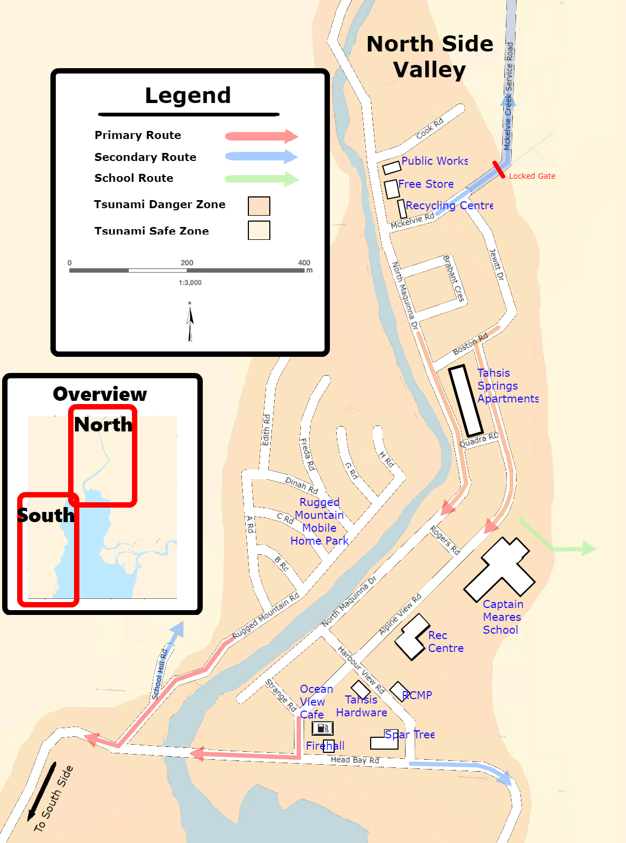
Evacuation Routes
Alternate routes for immediate evacuation
Evacuation route for public works
Evacuation route for school
Evacuation route for fire department

Slide 15
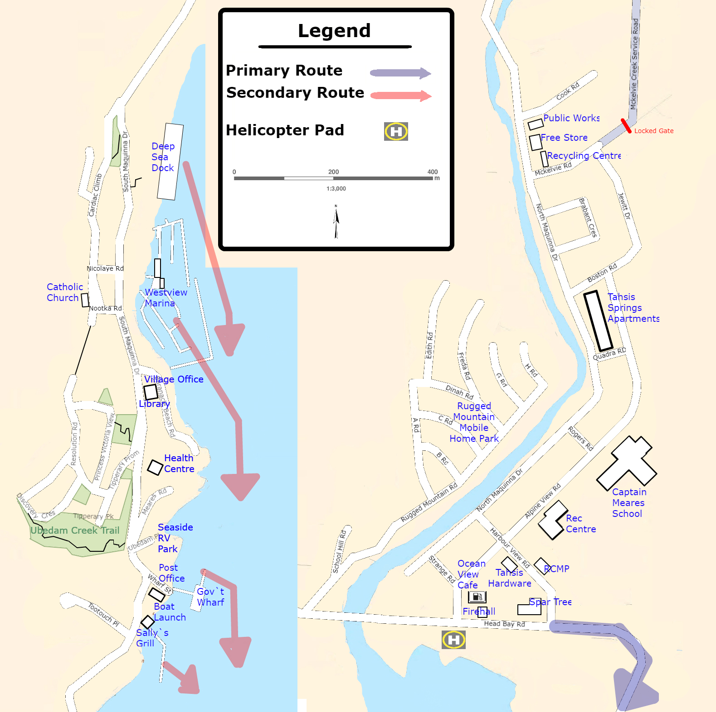
Road Closure
In the event that Head Bay road is closed for an extened amount of time alternate water routes can be utilized.
Offers ways to supply town
Alternate evacuation route if needed
Bridges will be closed until inspected in the event of an earthquake.

Slide 16


Continued improvements to evacuation planning
The Village of Tahsis has been awarded a grant from UBCM to impove our evacuation planning and is currently working with McElhanney to implement this grant.

